Slide 1


HUM 102 Report Writing Skills
Lecture 12

Slide 2

Previous Lecture
The writing process
Stage 02 - writing techniques with examples

Slide 3


The Writing Process
Three Stages
Pre-writing – Planning
Writing – Drafting
Post-writing – Finishing

Slide 4


Stage 03: Post-Writing
Steps
Responding
Revising
Editing
Proofreading
Publishing

Slide 5
Stage 03: Post-Writing
Steps: Responding
Self-Evaluation
Peer-Evaluation

Slide 6
Stage 03: Post-Writing
Steps: Revising
Revising your work is about making “big picture” changes.
You might remove whole sections, rewrite entire paragraphs, and add in information which you’ve realized the reader will need.
The revision stage is sometimes summed up with the A.R.R.R approach:
Adding
Rearranging
Removing
Replacing

Slide 7
Stage 03: Post-Writing
Steps: Revising – A.R.R.R Approach[1/4]
Adding:
What else a reader needs to know? If you haven’t met the required word-count, what areas could you expand?
This is a good point to go back to your prewriting notes – look for ideas which you didn’t use.

Slide 8
Stage 03: Post-Writing
Steps: Revising – A.R.R.R Approach[2/4]
Rearranging:
Sections may need rearranging.
Reordering paragraphs – better flow of argument.
Short story that drags in the middle but packs in too much at the end requires rearrangement.

Slide 9
Stage 03: Post-Writing
Steps: Revising – A.R.R.R Approach[3/4]
Removing:
Sometimes, one of your ideas doesn’t work out. Perhaps you’ve gone over the word count, and you need to take out a few paragraphs.
E.g., maybe that funny story doesn’t really fit with the rest of your article.

Slide 10
Stage 03: Post-Writing
Steps: Revising – A.R.R.R Approach[4/4]
Replacing:
Would more vivid details help bring your writing to life?
Do you need to look for stronger examples and quotations to support your argument?
Try rewriting paragraphs.

Slide 11
Stage 03: Post-Writing
Revise the following sentences to avoid flabby (weak) expressions, long lead-ins, and unnecessary there is/it is fillers.
This e-mail message is to inform you that there is a new health benefit plan available for employees.
A new health benefit plan is available for employees.
I would like to take this opportunity to inform everyone that in all probability we expect to win the contract.
We probably will win the contract.

Slide 12
Stage 03: Post-Writing
Revise the following sentences to achieve conciseness.
In addition to the above, there are contracts that are attached hereto.
Two contracts are also attached.
Despite the fact that most information is posted on the company intranet, please feel free to call whenever necessary.
Although most information is posted on the company intranet, please call whenever necessary.

Slide 13
Stage 03: Post-Writing
Revise the following sentences to avoid redundancies, dull and overused expressions, jargon, and slang.
Ms. Miller, who shoots straight from the shoulder, demanded final completion by January 1.
Ms. Miller, who is straightforward, demanded completion by January 1.
Pursuant to your request, enclosed please find a check for $150.
As you requested, a check for $150 is enclosed.

Slide 14
Stage 03: Post-Writing
In the following sentences, control the use of verbs and exuberance.
The seller said he definitely would contact you.
The seller promised to e-mail (telephone or fax) you.
We must give encouragement to our team.
We must encourage our team.

Slide 15
Stage 03: Post-Writing
Arrange the following in a concise, bulleted vertical list.
In the next training session, the trainer will demonstrate how to create podcasts, how to share multiple programs, and how to maintain an Internet directory.
The next training session will demonstrate:
creating podcasts
sharing multiple
programs
maintaining an internet directory

Slide 16
Stage 03: Post-Writing
Improve the readability of the following instructions that will become part of a student’s employment booklet.
In preparing for an employment interview, you should begin by studying the job description. Itemizing your most strategic skills and qualifications is also important. Giving responses in a mock interview is another good practice technique. Lastly, you should be prepared to ask relevant questions.
You can prepare for interviews by:
studying the job description.
itemizing your most
strategic skills and
qualifications.
practicing giving responses in a mock interview.

Slide 17
Stage 03: Post-Writing
Steps: Editing [1/3]
The editing stage is distinct from revision, and needs to be done after revising.
Editing involves a close-up view of individual sentences and words.
It needs to be done after you’ve made revisions on a big scale.
When editing, go through your piece line by line, and make sure that each sentence, phrase and word is as strong as possible.

Slide 18
Stage 03: Post-Writing
Steps: Editing [2/3]
Using one word many times in one sentence or paragraph? Use a thesaurus to find alternatives.
Sentences hard to understand? Rewrite them to make your thoughts clear.
Which words could you cut to make a sentence stronger? Words like “just” “quite”, “very”, “really” and “generally” can often be removed.
Are your sentences grammatically correct? Keep a careful look out for problems like subject-verb agreement and staying consistent in the use of tense.
Is everything spelt correctly? Don’t trust your spell-checker – it won’t pick up every mistake. Proofread as many times as necessary.
Have you used punctuation marks correctly? Commas often cause difficulties. You might want to check out the Daily Writing Tips articles on punctuation.

Slide 19
Stage 03: Post-Writing
Steps: Editing [3/3]
Editing is where things like grammar, spelling and mechanism are checked and refined.
Re-reading is a key part of editing; make sure everything is exactly how you want it.
Reading aloud or having someone read to you can be very helpful because you may hear things differently in your head than when you hear them out loud.
Ensure that the formatting is correct.
This is the last process of writing your document.

Slide 20
Stage 03: Post-Writing
Steps: Proofreading
Final phase
To make a final check and fix mechanical or technical flaws, such as:
Grammar
Punctuation
Names and numbers
Format
Also involves checking of different elements of a layout (such as headlines, paragraphs, illustrations, and colors) for their correct dimensions, placement, type, etc.

Slide 21
Stage 03: Post-Writing
Steps: Proofreading – what to watch for?
Spelling
Insertion
Deletion
Capitalization
Punctuation
Names and numbers
Format

Slide 22
Stage 03: Post-Writing
Steps: Proofreading – Checklist
Writer’s Checklist should provide a useful starting point for proofreading:
First-Phase Review
Appropriate format (reports or correspondence?)
Consistent style, including headings, terminology, spacing, fonts
Correct numbering of figures and tables
Second-Phase Review
Specific grammar and usage problems
Appropriate punctuation
Correct abbreviations and capitalization
Correct spelling (especially names and places)
Complete web or e-mail addresses
Accurate data in tables and lists
Cut-and-paste errors; for example, a result of moved or deleted text and numbers

Slide 23
Stage 03: Post-Writing
Steps: Proofreading – Checklist
Writer’s Checklist should provide a useful starting point for proofreading:
Final-Phase Review
Survey of your overall goals: audience needs and purpose
Appearance of the document (see layout and design)
Review by a trusted colleague, especially for crucial documents

Slide 24
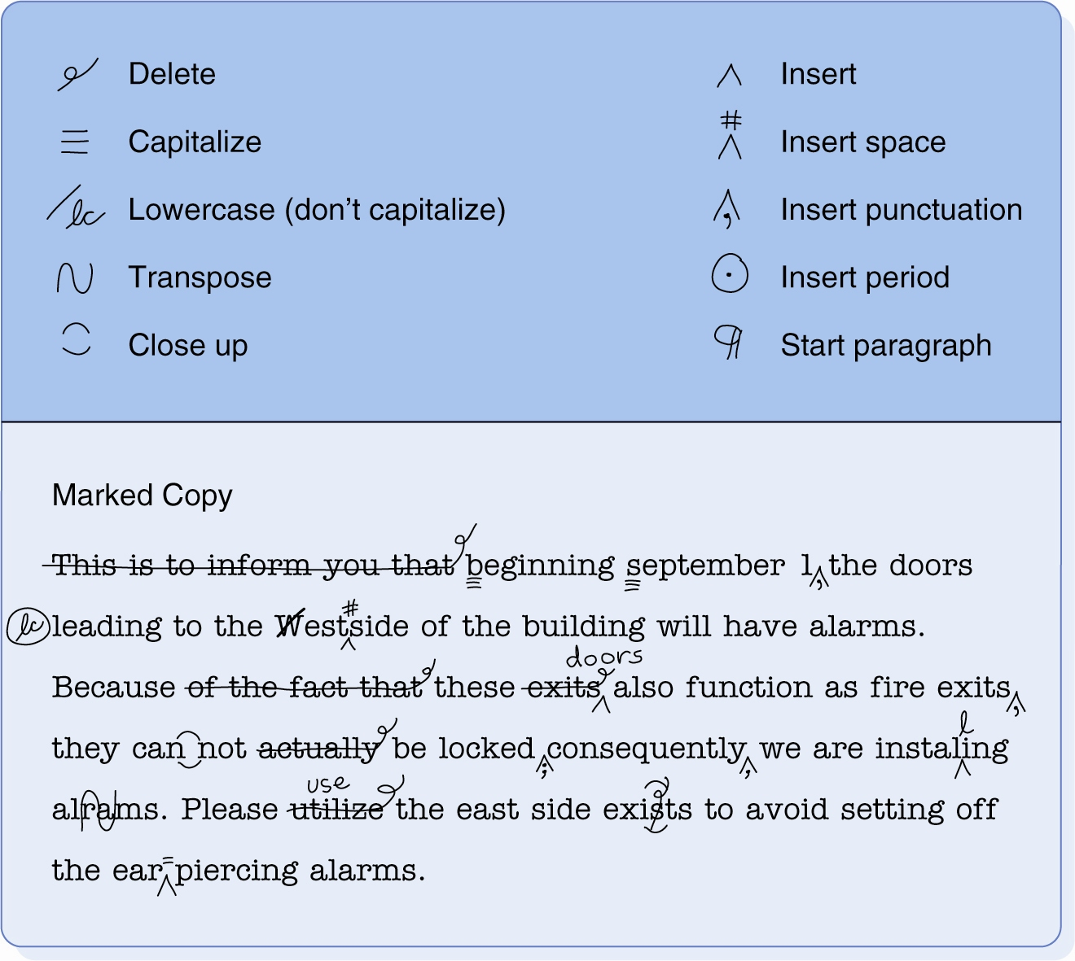
Stage 03: Post-Writing
Steps: Proofreading – Marks

Slide 25
Stage 03: Post-Writing
Steps: Proofreading – An example

Slide 26
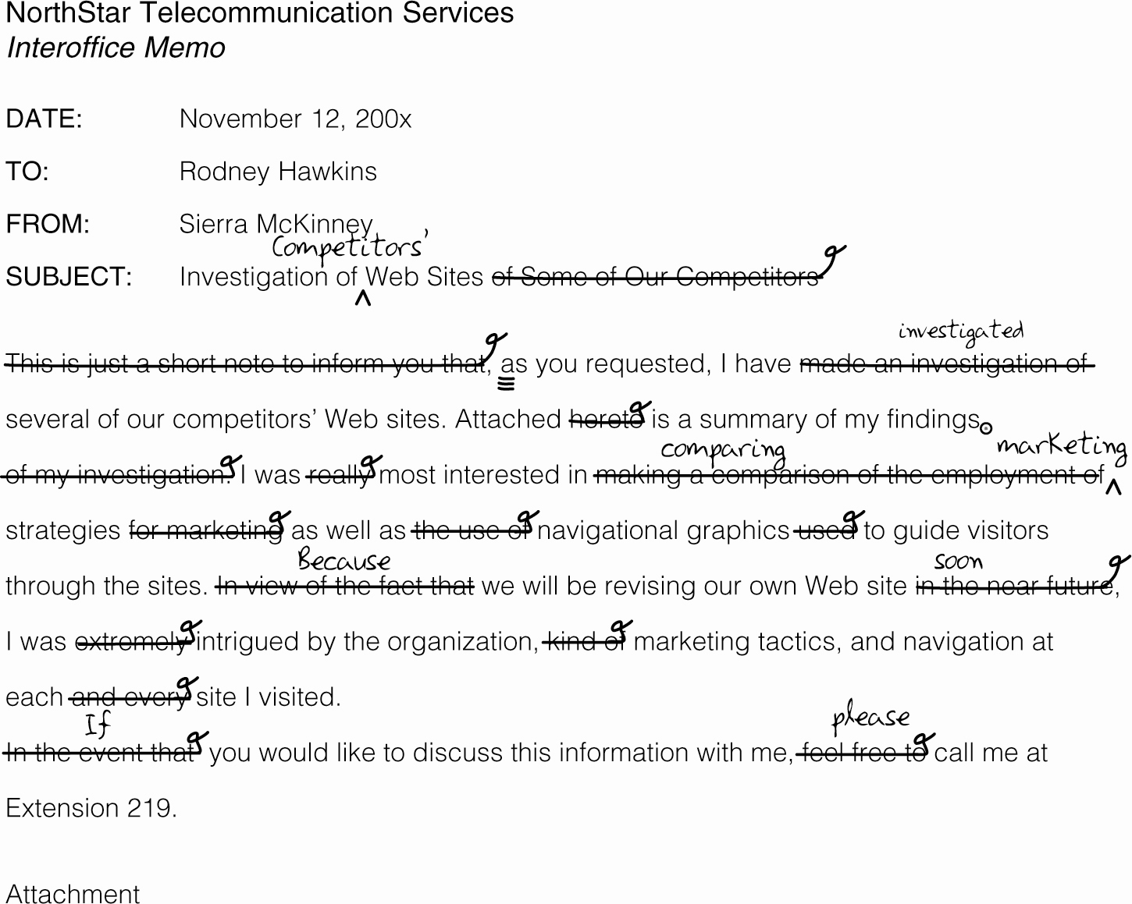
Stage 03: Post-Writing
Content Revised for Conciseness

Slide 27
Stage 03: Post-Writing
Steps: Publishing
The final step of the writing process is publishing, but it’s the step where you’re given an opportunity to share your work.
Secure any necessary co-authorship and/or copyright permissions.
This often means adding a bibliography, ensuring that citations are correct, to secure copyrights of your original work.

Slide 28
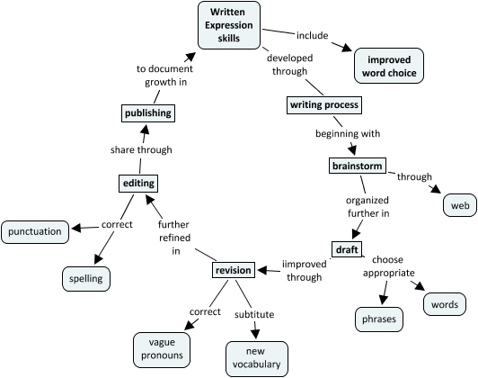

Slide 29
Conclusions
The writing process
Stage 03: Post-writing techniques with examples

